Slide 1
SEARCH ENGINE OPTIMIZATION (SEO)

Slide 2
agenda
Introduction to SEO
Keyword Research
On Page SEO
Technical SEO
Hands On

Slide 3

What is SEO

Slide 4
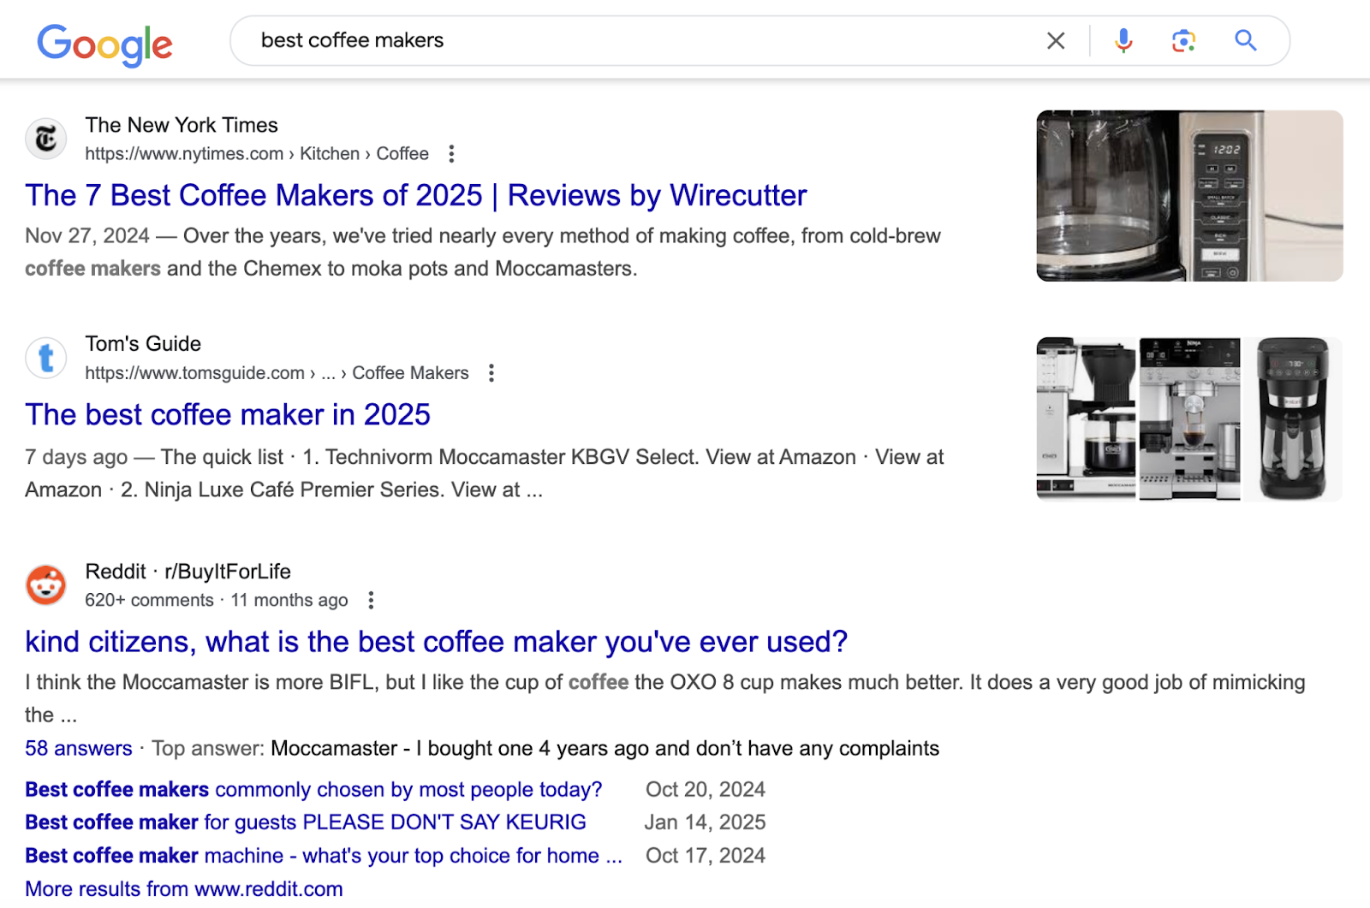
SEO
Search engine optimization (SEO) is the process of improving your website to help it appear more prominently for relevant topics when people search using Google and other search engines.
For example, SEO helps websites focusing on the term “best coffee makers” appear among the top results.

Slide 5
Importance of SEO
SEO is important because it brings free, targeted traffic to your website every month.
Consider that most online experiences start with a search engine.
When someone needs a product, service, or information, they head straight to Google. If your website shows up for these searches, you can attract visitors actively looking for what you offer.
Plus, people generally trust organic (free) results more than ads.
Users know businesses pay for ad spots, but earning a top organic spot means Google considers your content relevant and helpful. This can help build credibility with potential customers.
The best part?
Once you rank well, you can get consistent organic traffic without paying for visitors.
Compare that to social media, where your posts lose traction over time. Or paid ads that drain your budget with every click.

Slide 6
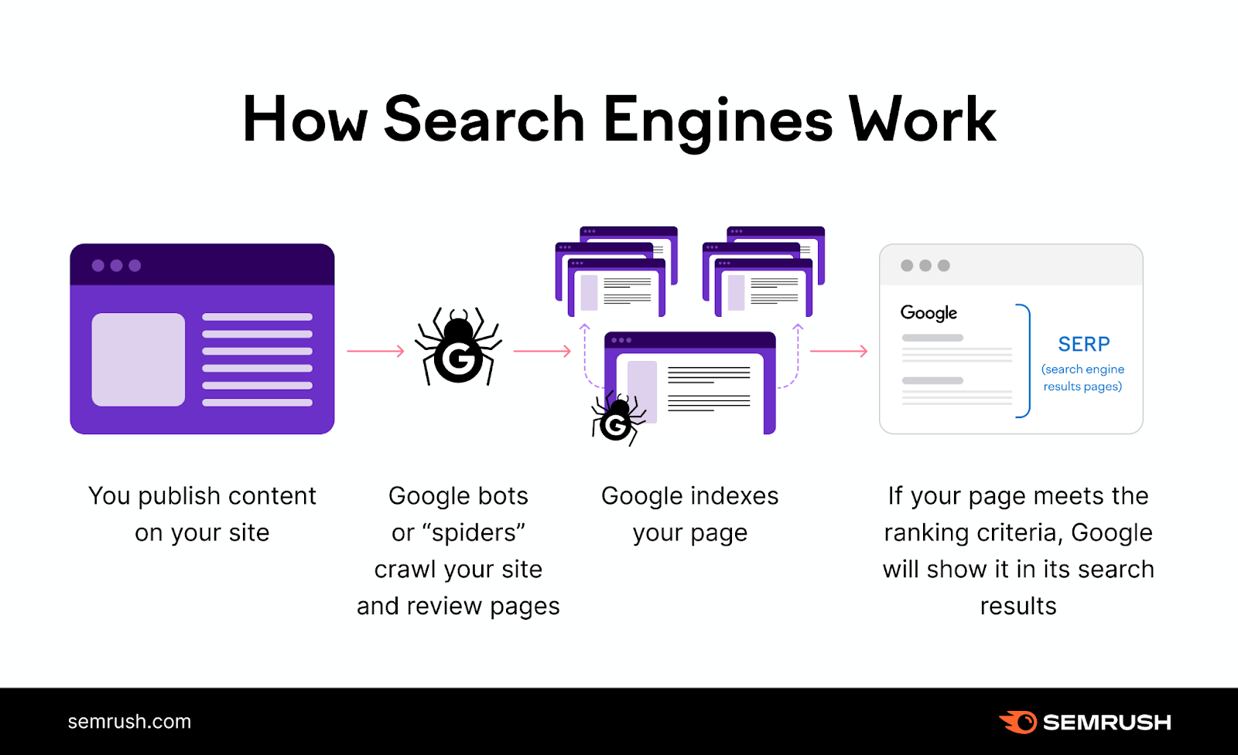
How DOES Google Index Your Site?
The first step to SEO is making sure Google can crawl (find) and index (i.e., store your pages in a database) your site.
Google uses crawlers (also known as spiders) to discover pages and read their content. It can then add those pages to its index.
Here’s a simplified visualization of how crawling, indexing, and displaying results works (though there are problems that can get in the way of any step in the process):
To help Google crawl and index your pages, you’ll want to use Google Search Console. This free tool shows you how Google sees your pages and alerts you about major issues that could hurt your rankings.
Sign up for GSC to begin.
After setting up your account, create an XML sitemap to guide crawlers.

Slide 7
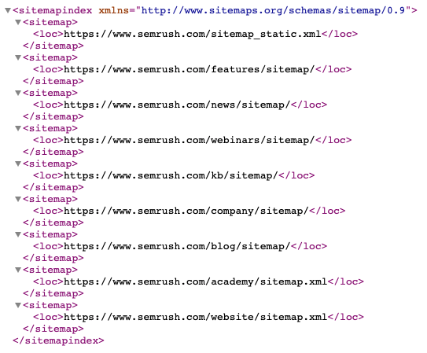
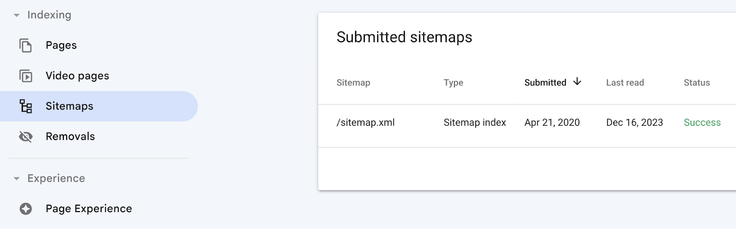
How Do You Make Sure Google Can Index Your Site?
Most website platforms (like WordPress and Wix) create sitemaps automatically. But you can also create one using a tool like XML Sitemaps Generator.
Once you have a sitemap, submit it in Search Console by going to “Sitemaps” and entering your sitemap URL.
The status column should read “Success.”

Slide 8

Keyword RESEARCH
Enhancing your Search capabilities

Slide 9
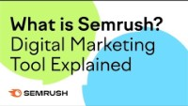
About semrush

Slide 10
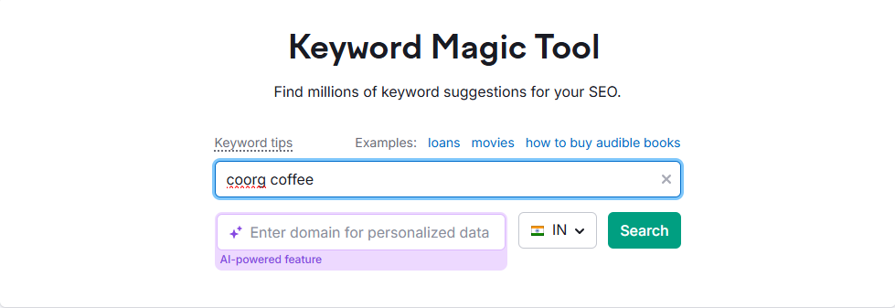
Effective KEYWORD RESEARCH
Keyword research is the process of identifying terms your potential customers use when searching for topics related to your brand, products, or services.
In other words, keyword research shows you what users are actually searching for. So you can create content that answers their queries and attracts them to your site.
For example, a coffee shop owner might know that “best coffee shop” is a good keyword to target.
But they likely need to do keyword research to find out that their audience is also searching for queries like “where to get oat milk lattes” and “coffee shop with workspace near me.”
Effective keyword research lets you find topics your audience cares about and understand the search intent (the goal behind the search), so you can create effective content.
Find relevant keywords using the Keyword Magic Tool.
Enter a broad term related to your niche, set a country, and click “Search.”

Slide 11
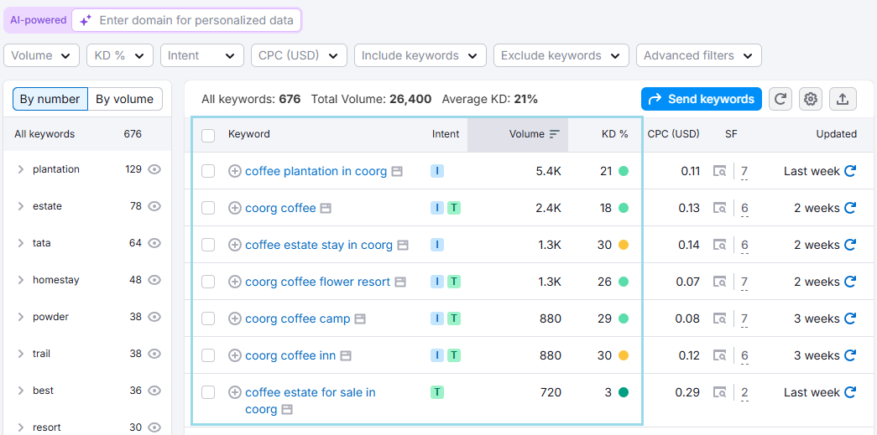
Effective KEYWORD RESEARCH
When choosing keywords for your site (or a specific page), focus on relevance first.
For example, a business shouldn’t target “specialty coffee” if it doesn’t sell specialty coffee.
After ensuring relevance, consider two other keyword metrics:
Volume: The keyword search volume—the average number of monthly searches
KD %: The keyword difficulty score—a measure of how challenging it will be to achieve a top-10 ranking for a given term
Keep in mind that ranking highly for low-volume, highly relevant keywords often drives valuable traffic.
Start small, then aim for more competitive terms as your site’s SEO performance improves

Slide 12
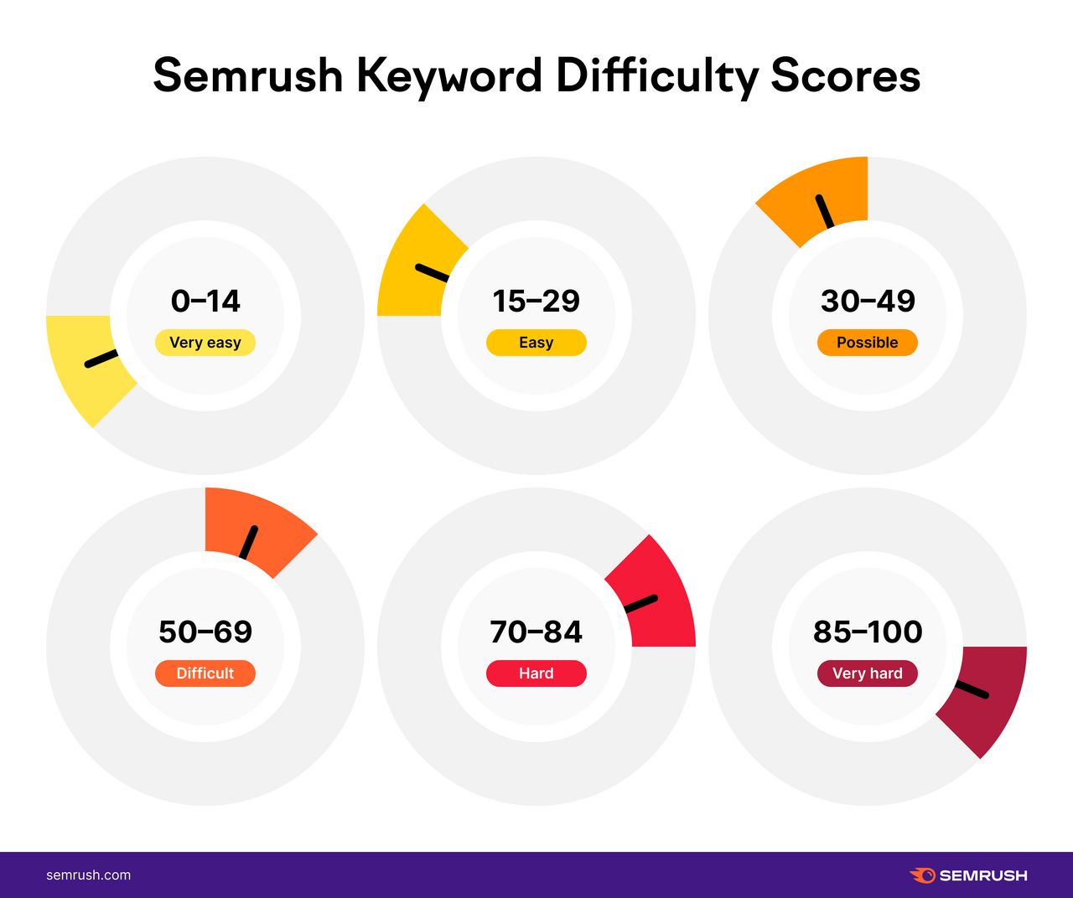

Slide 13
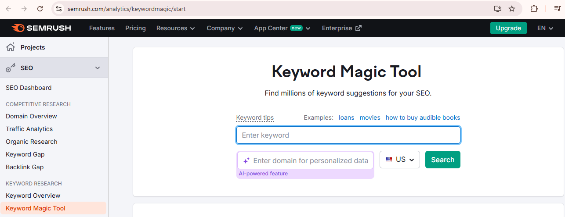
Quick Assignment
Open Semrush’s keyword research tool and search for the search patterns of atleast 3 keywords of your choice. Note the words Volume and KD%
Link
Open Google Trends and note the short term, kid term and long term trends of a region and also 3 Keywords of your choice

Slide 14
CREATING HIGH QUALITY CONTENT
SO THAT YOUR AUDIENCE LOVES IT!!

Slide 15
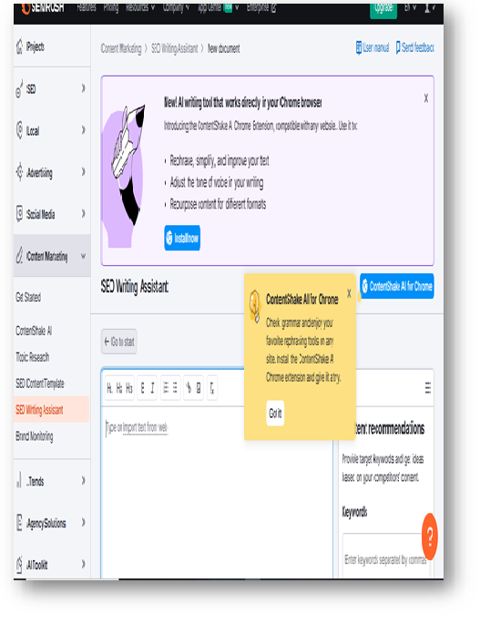
High quality content
High-quality content is accurate, helpful, trustworthy, relevant, and user-friendly, which is exactly the type of content Google wants to reward.
Some characteristics of quality content include:
Thorough coverage of the topic
Clear organization and structure
Up-to-date information
Expert insights and/or original research
Engaging visuals
Error-free writing
Mobile-friendly formatting
Use the SEO Writing Assistant to help you craft quality content.
Add your target keywords, and the tool will provide recommendations for readability, originality, tone of voice, and SEO.

Slide 16
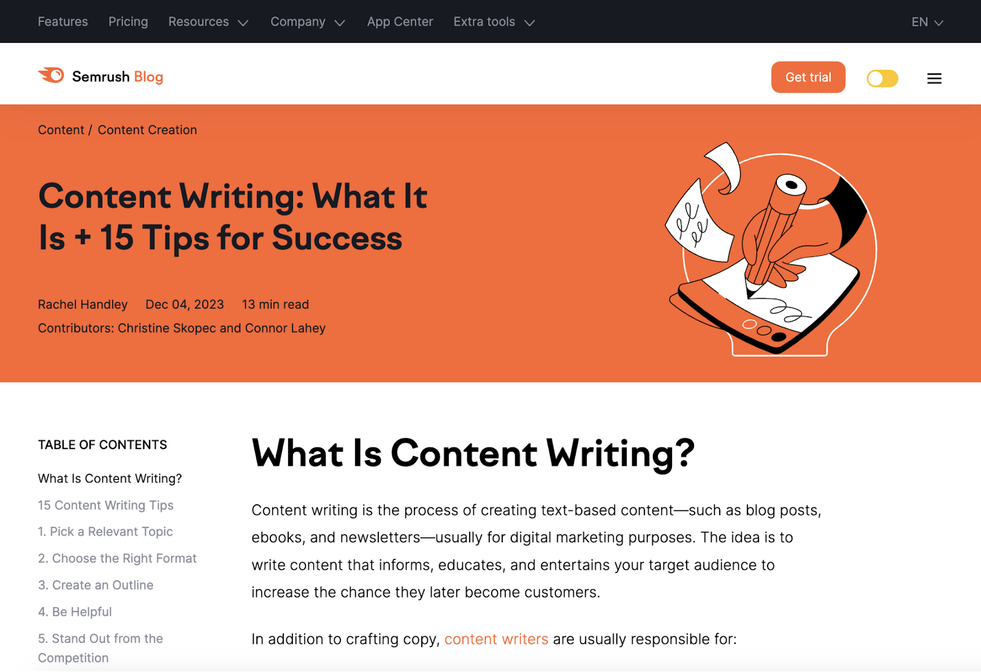
Optimize Content that Appears Above the Fold
Content that appears “above the fold” refers to the first screen users see when they land on your webpage and serves as the page’s first impression.
If visitors don’t quickly find what they’re looking for, they might leave. Which can hurt your performance.
A good above-the-fold section does the following:
Includes your main keyword naturally
Clearly provides value
Uses clear, simple language
Avoids intrusive elements

Slide 17
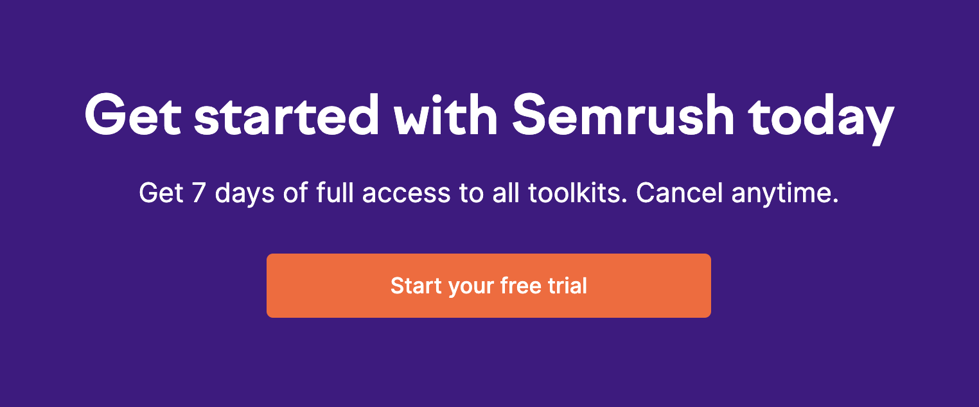
Above the Fold – BEST PRACTICES
User experience (UX) is how visitors interact with and perceive your site (its design, usability, etc.)—and Google values a positive user experience.
Here are some key best practices for ensuring a positive UX:
Use Enticing CTAs
A call to action (CTA) is a prompt that encourages site visitors to take a specific action, like subscribing to your newsletter, scheduling a demo, or making a purchase.
Make your CTAs specific and value-focused:
Not great: "Click here"
Better: "Get your free SEO checklist"
Here’s an example of a CTA to get visitors to sign up for a free trial:
The CTA is clear, highlights a tangible benefit, and drives action.
Place your main CTA above the fold for conversion-oriented pages
and test variations to see what resonates best with your audience.

Slide 18
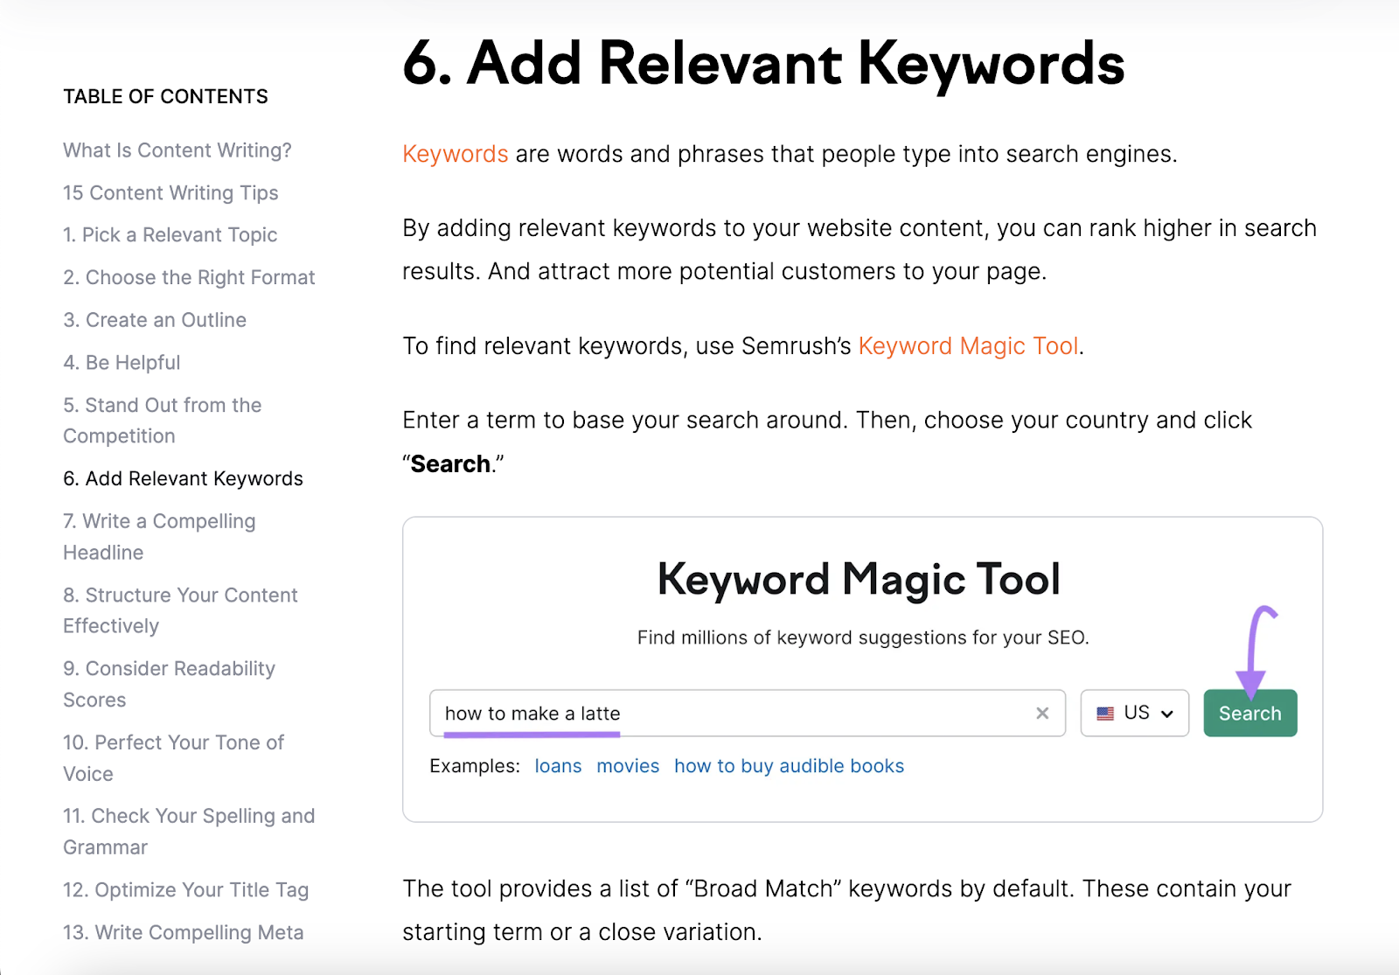
Above the Fold – BEST PRACTICES
2. Avoid walls of Text
Most readers scan rather than read every word, so steering clear of large blocks of text makes it easier to quickly spot key information.
Break up your content into easy-to-scan chunks by doing the following:
Use short sentences and paragraphs
Add white space
Include images or other visual breaks every 200-300 words
Write descriptive subheadings
For example, the screenshot on the side uses short paragraphs, images, and headings to break up the text. Which makes it very easy to read and follow.

Slide 19
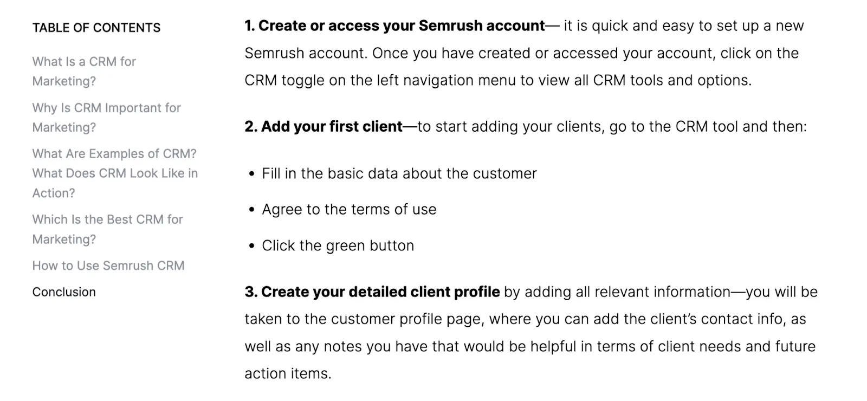
Above the Fold – BEST PRACTICES
3. Use Bullets, Numbered Lists, and Short Paragraphs
Here are some ways to use these elements effectively:
Turn long paragraphs into bullet points
Start list items with action words
Keep bullets consistent in length and style
Use numbered lists for step-by-step instructions
Use a mix of short paragraphs, lists, and visuals to create rhythm throughout your pages
Check out this example(side) from an example blog posts.

Slide 20

ASSIGNMENT
HANDS ON TIME!!

Slide 21

Optimising Your Website's First Impression
Aim : Crafting Effective Above-the-Fold Content
Objective: To understand the importance of the "above the fold" section of a webpage and apply best practices for creating engaging and effective content in this crucial area.
Instructions:
Imagine you are a digital marketing specialist tasked with improving the user experience and SEO performance of a client's website. For this assignment, you will either analyse an existing website's above-the-fold section or create a hypothetical above-the-fold section for a given scenario.
Part 1: Analysis of an Existing Website (Option A)
1.Choose a website from a business or organisation you are familiar with.
2.Analyse the "above the fold" section of their homepage or a key landing page. Consider the following aspects, drawing on the information from the sources:

Slide 22
Optimising Your Website's First Impression
Keyword Inclusion: Does it include the main keyword(s) naturally?
Value Proposition: Does it clearly communicate the value the website offers to visitors?
Language: Is the language clear and simple?
Intrusive Elements: Are there any elements that might be considered intrusive and detract from the initial impression?
Call to Action (CTA): If the page has a primary conversion goal, is there a clear and value-focused CTA visible above the fold? Is it specific?
Visual Appeal: Does the initial visual impression support the content and encourage further engagement? (Note: This goes slightly beyond the text in the sources but is relevant to UX).
Scalability: Is the content broken up into easy-to-scan chunks using short sentences, paragraphs, white space, images, or subheadings?
3.Write a brief report (250-300 words) outlining your findings. Identify the strengths and weaknesses of the website's above-the-fold content based on the principles discussed in the sources. Suggest specific improvements that could be made to enhance user engagement and potentially improve performance.

Slide 23
Optimising Your Website's First Impression
Part 2: Creating Hypothetical Above-the-Fold Content (Option B)
A local bakery wants to attract more customers to their shop.
An online retailer selling eco-friendly household goods wants to highlight their unique selling proposition.
A software company offers a free trial of their latest product.
2. Design the "above the fold" section for the homepage of this business. Your design should include:
A compelling headline that incorporates a relevant keyword naturally.
Clear and concise text that immediately provides value to the visitor.
Clear, simple language, avoiding jargon.
A specific and value-focused Call to Action (CTA) if applicable to your scenario.
Consider how you would break up the text for easy scanning, even if you are just describing the elements.
3. Write a brief explanation (200-250 words) justifying your design choices. Explain how your above-the-fold content adheres to the principles discussed in the sources and how it aims to improve user experience and encourage further interaction with the website.

Slide 24

ON PAGE SEO
Optimize your Page

Slide 25
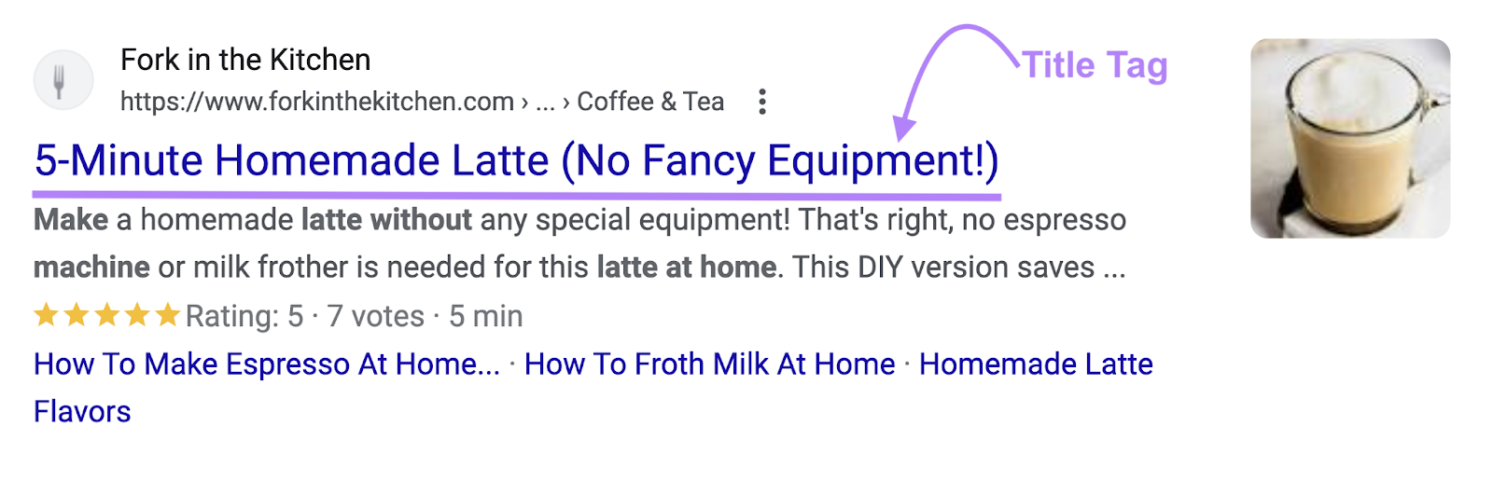
Introduction
On-page SEO is the process of optimizing a page’s content, HTML elements, and structure to provide a better user experience and increase your chances of ranking well.
Here are some on-page SEO elements you can optimize today:
Title Tags
Title tags are HTML titles that can appear as clickable headlines in search results.
Google uses title tags to understand your content's topic. But, more importantly, compelling titles convince people to click through to your site.
Do the following to write effective title tags:
Stay between 50-60 characters
Include a target keyword
Clearly describe the page
Write a unique title tag for each page.

Slide 26
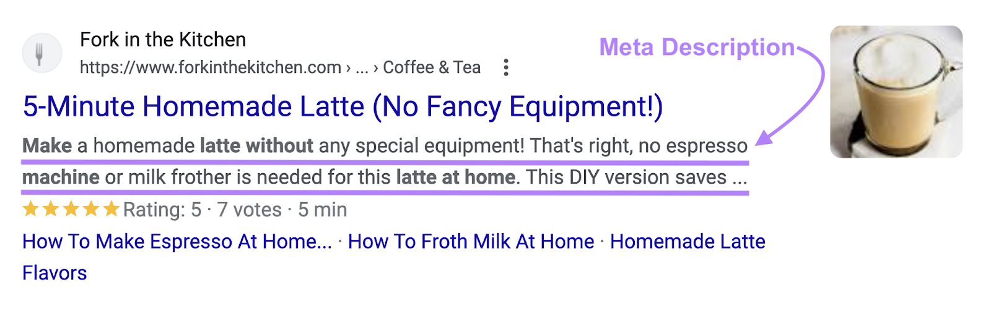
Meta tags
Meta Descriptions
Meta descriptions are short summaries of a page that can appear as a snippet below the title on SERPs.
While meta descriptions don't directly affect rankings, they can influence click-through rates.
To write effective meta descriptions, do the following:
Stick to 105 characters or fewer
Include the target keyword naturally
Highlight the page's value
Include a clear CTA
Write a unique meta description for each page.

Slide 27
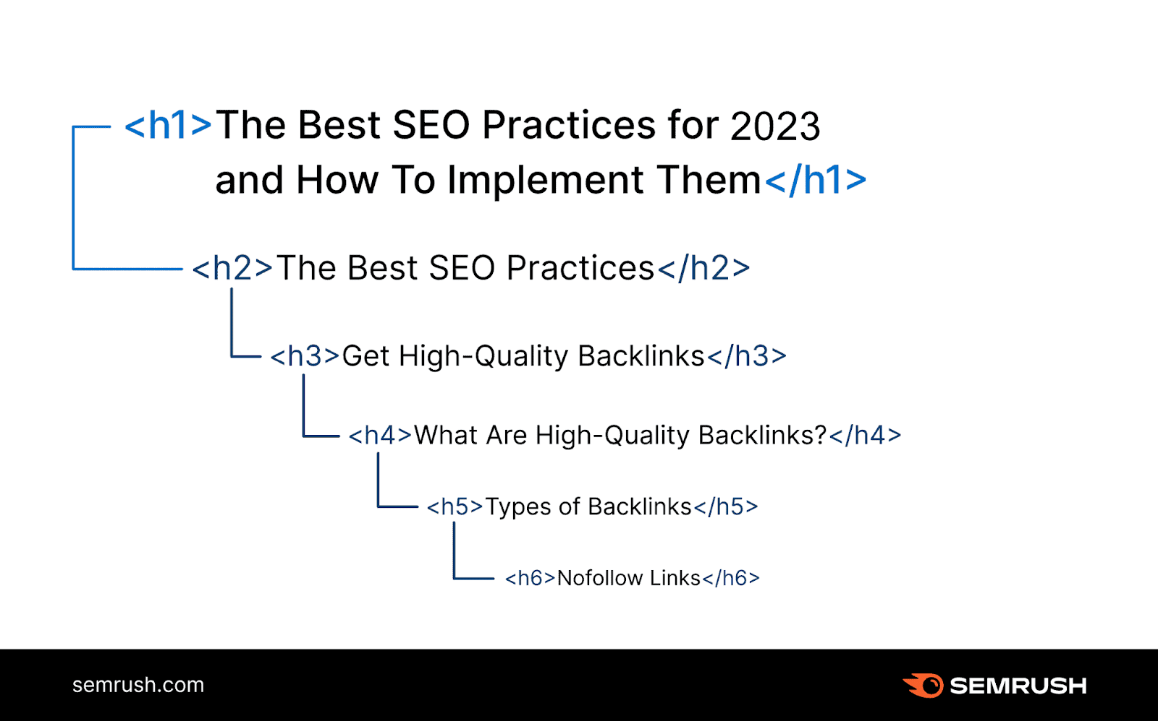
Heading Tags
Heading tags are HTML tags on pages that organize your content into sections and help Google understand the structure of your pages.
It’s best to use headings and subheadings (H2-H6) to segment topics in a hierarchical and logical way.
Here are some other tips to use heading tags effectively:
Include one H1 tag per page
Use your target keyword in the H1
Structure main topics with H2s and subtopics with H3s and smaller
Keep headings descriptive and clear

Slide 28
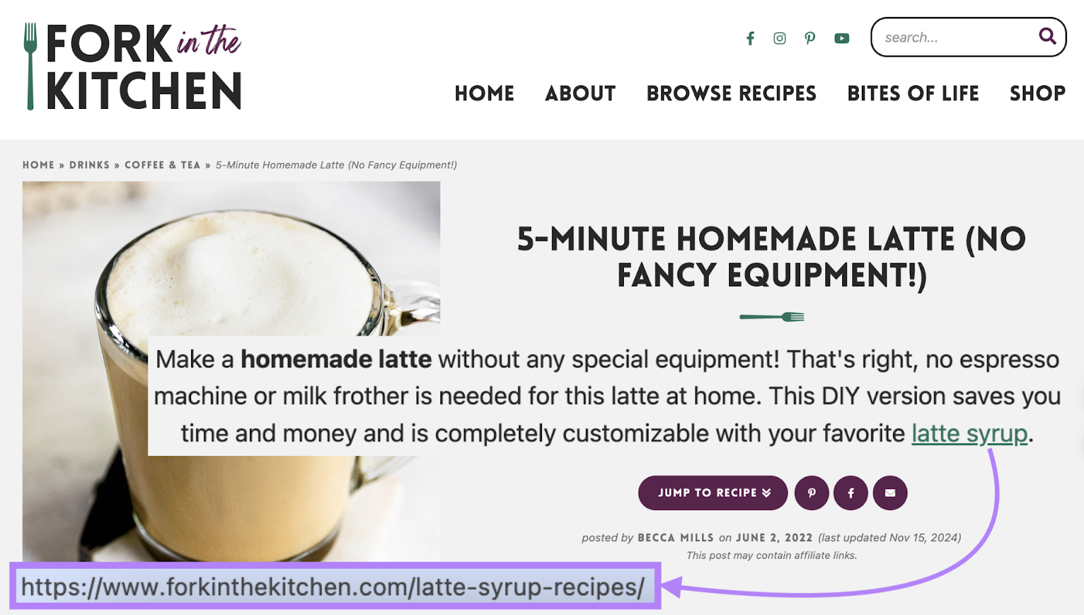
Internal Links
Internal links point from one page on your site to another page on your site—they help search engines understand your site’s structure, pass link authority, and help users find related content.
Here’s what an internal link looks like on a live page:
Use internal links effectively by doing the following::
Use descriptive anchor text (the clickable, linked text)
Add relevant internal links to new pages
Audit and fix broken internal links regularly
Also, consider giving low-performing pages a boost by linking to them from your pages with high link authority to share authority between pages.

Slide 29
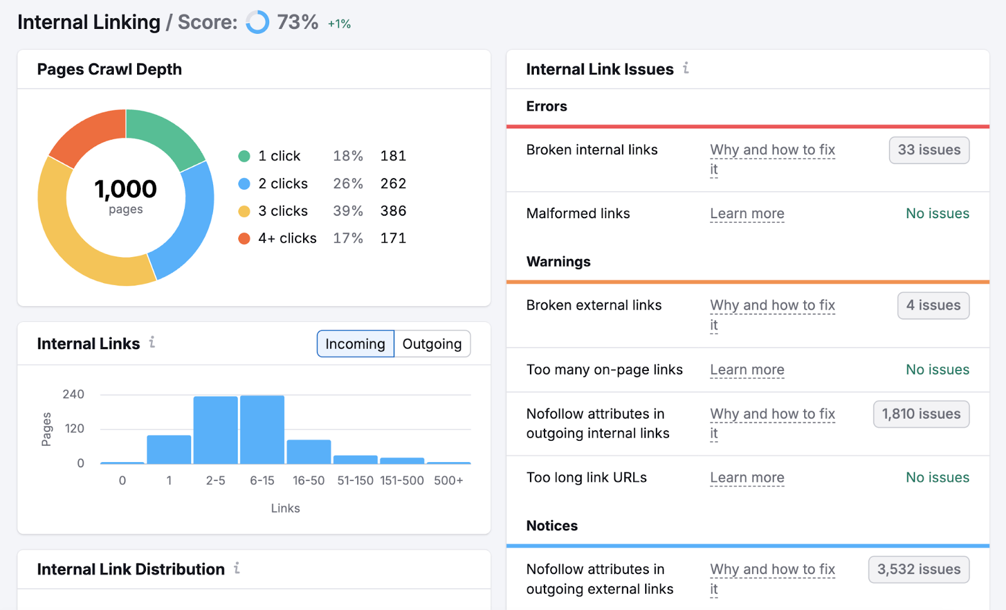
Use internal links effectively by doing the following:
Use descriptive anchor text (the clickable, linked text)
Add relevant internal links to new pages
Audit and fix broken internal links regularly
Also, consider giving low-performing pages a boost by linking to them from your pages with high link authority to share authority between pages.
Find pages with high link authority using the Internal Linking report in Site Audit. And link from those pages to your underperforming pages.

Slide 30
Page URLs
To optimize your URLs:
Keep them descriptive but concise
Use your primary keyword
Separate words with hyphens
Remove unnecessary words (“a,” “the,” “and.” etc.)
Avoid special characters
Images
Images can make your content more engaging and bring in traffic through Google image searches.
But search engines can't "see" images. So, you need to make sure they can understand what’s being shown.
To optimize images for search:
Use descriptive file names (mountain-hiking-gear.jpg—not IMG001.jpg)
Add relevant alt text to describe each image (include your keyword when it makes sense)
Compress files to improve loading speed with tools like TinyPNG
Choose the right file format (WebP is often best, but you can also use JPG for photos and PNG for graphics)

Slide 31
Link Building
To optimize your URLs:
Keep them descriptive but concise
Use your primary keyword
Separate words with hyphens
Remove unnecessary words (“a,” “the,” “and.” etc.)
Avoid special characters
Images
Images can make your content more engaging and bring in traffic through Google image searches.
But search engines can't "see" images. So, you need to make sure they can understand what’s being shown.
To optimize images for search:
Use descriptive file names (mountain-hiking-gear.jpg—not IMG001.jpg)
Add relevant alt text to describe each image (include your keyword when it makes sense)
Compress files to improve loading speed with tools like TinyPNG
Choose the right file format (WebP is often best, but you can also use JPG for photos and PNG for graphics)

Slide 32
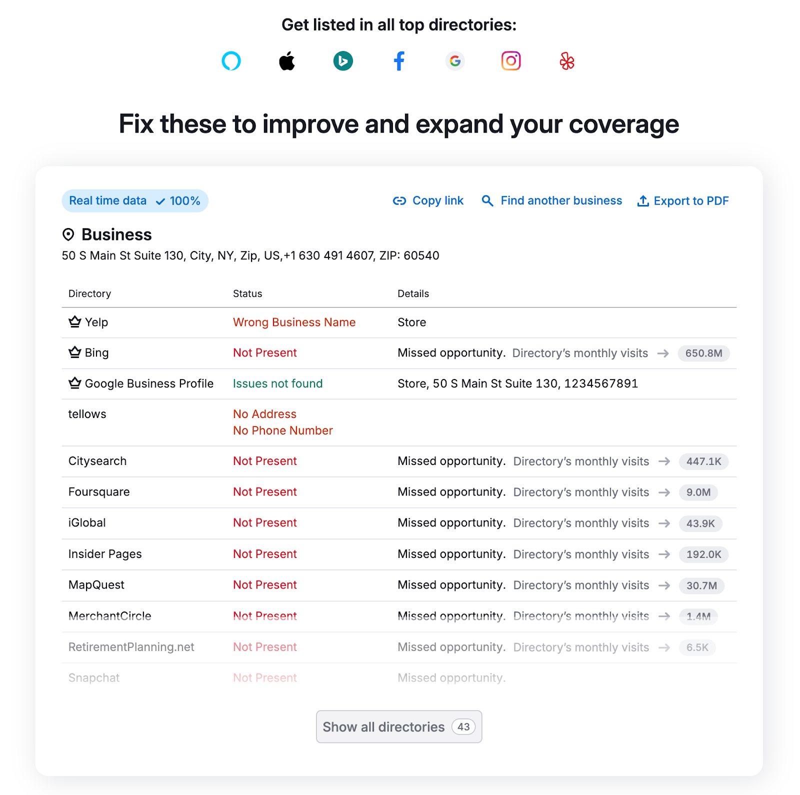
Build Links from Associations, Suppliers, and Connected Business
You already have connections with other businesses, so turn those relationships into links.
Many of your suppliers, business partners, and industry associations have partner pages or member directories where they can link to your site.
Start by making a list of:
Companies you buy from
Professional organizations you belong to
Business partners you work with
Chambers of commerce in your area
Then, reach out with a simple email asking to be added to their partners page. Since you already have a relationship, many will be happy to link to you.
Submit Your Site to Quality Directories
If you’re a local business or work in a specific niche, getting your site on a legitimate directory can send you traffic and possibly some link authority.
Focus on industry-specific directories where your customers are likely to find you.
And be aware that most well-known directories (Yelp, Yellow Pages, etc.) use attributes that tell search engines not to treat the links as endorsements. Which can make those links less valuable than standard links.
Use a tool like Listing Management to automatically submit your business information to top directories.

Slide 33
Thank you

